Slide 1

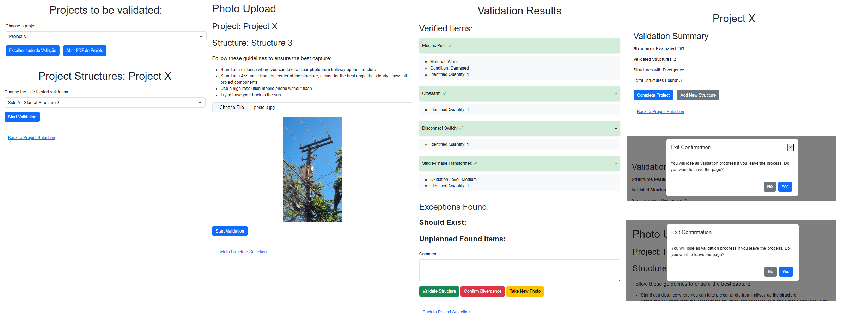





POC ENEL LLM IDENTIFIER
Validation of Project Structures with OpenAI
Context
Strategy
COE
xTech
PROBLEM
Manual validation of electric pole structures is time-consuming and prone to errors.
High consumption of time and resources in manual validation.
OBJECTIVE
Automate the validation of electric pole structures to reduce the time and necessary resources, improving the efficiency and accuracy of the process.
ACTIVITIES
Flask application as the main interface: Allows the upload of photos of the structures for processing.
Photo upload of the structures: Simplifies the collection of visual data for analysis.
Processing with OpenAI API: Utilizes artificial intelligence to analyze and validate the submitted images.
DELIVERABLES
PROJECT TYPE / CATEGORY
Gen AI
TEAM
1
YEAR
2024
DURATION
2 semanas
COUNTRY
Brasil
TECHNOLOGIES
Benefits
Improved operational efficiency: Optimizes the use of team and equipment resources, focusing on more strategic activities.
Increased validation accuracy: Reduces the incidence of human errors, ensuring greater reliability.
Generation of detailed reports: Facilitates the analysis and monitoring of validated structures.
Precise component identification: Increases confidence in the integrity of structures.

Slide 2
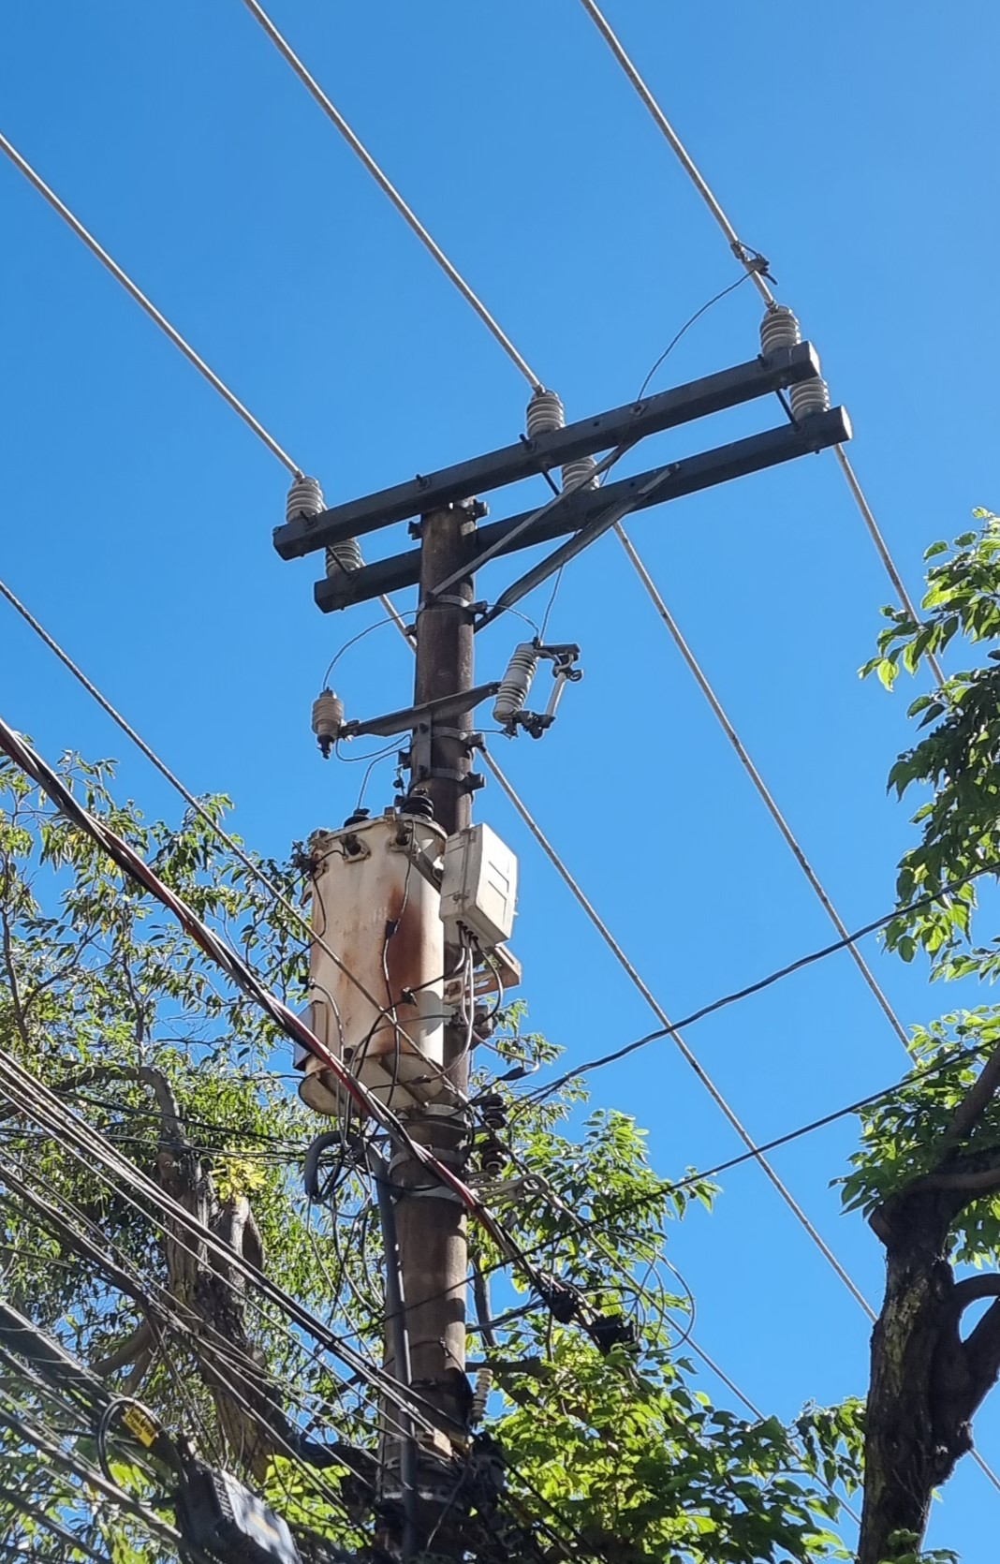
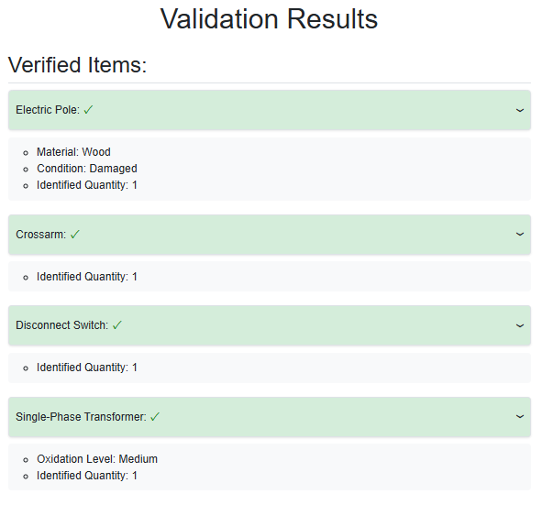

POC ENEL LLM IDENTIFIER
Validation of Project Structures with OpenAI
Pipeline
Structure Photo
Web Interface​
Prompt to extract structure characteristics.
JSON return and interpretation by the frontend.

Slide 3
POC ENEL LLM IDENTIFIER
Validation of Project Structures with OpenAI
Strategy
DELIVERABLES

Slide 4
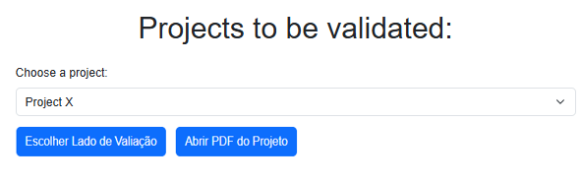
POC ENEL LLM IDENTIFIER
Validation of Project Structures with OpenAI
Strategy
DELIVERABLES
1 - Project selection

Slide 5
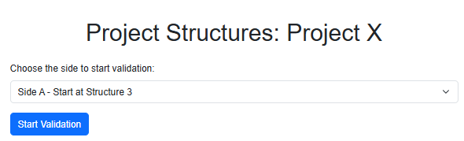
POC ENEL LLM IDENTIFIER
Validation of Project Structures with OpenAI
Strategy
DELIVERABLES
2 - Validation side selection

Slide 6
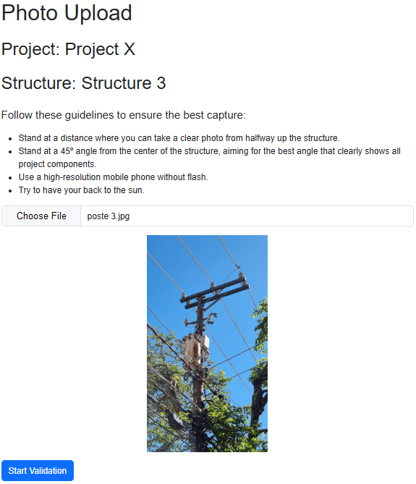
POC ENEL LLM IDENTIFIER
Validation of Project Structures with OpenAI
Strategy
DELIVERABLES
3 – Upload the structure photo for evaluation

Slide 7
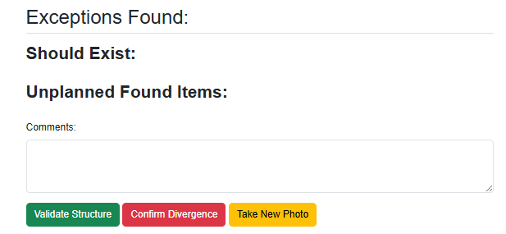
POC ENEL LLM IDENTIFIER
Validation of Project Structures with OpenAI
Strategy
DELIVERABLES
4 – Validation of the found components

Slide 8
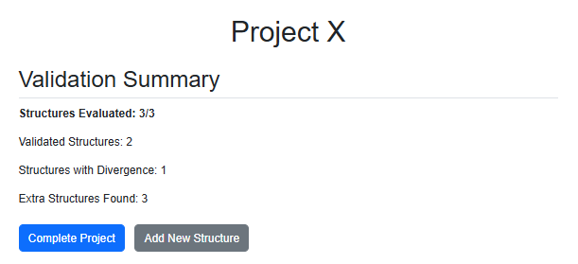
POC ENEL LLM IDENTIFIER
Validation of Project Structures with OpenAI
Strategy
DELIVERABLES
5 – Project summary and validation

Slide 9
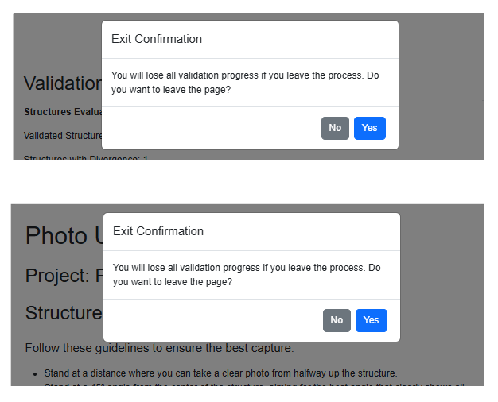
POC ENEL LLM IDENTIFIER
Validation of Project Structures with OpenAI
Strategy
DELIVERABLES
* Informative screens during the process, warning that if it is interrupted, the entire process will be lost.

